Slide 1
CS35L Software Construction Laboratory Lab 6 – Nandan Parikh Week 2; Lecture 1

Slide 2
Topics
More CommandS
Unix Wildcards
Basic Regular Expressions

Slide 3
Environment Variables
Variables that can be accessed from any child process
Common ones:
HOME: path to user’s home directory
PATH: list of directories to search in for command to execute
Change value:
export VARIABLE=…

Slide 4
Locale
A locale
Set of parameters that define a user’s cultural preferences
Language
Country
Other area-specific things
locale command
prints information about the current locale environment to standard output
Notes:
4

Slide 5
LC_* Environment Variables
locale gets its data from the LC_* environment variables
Examples:
LC_TIME
Date and time formats
LC_NUMERIC
Non-monetary numeric formats
LC_COLLATE
Order for comparing and sorting

Slide 6
The 'C' Locale
The default locale
An environment of “least surprise”
Behaves like Unix systems before locales

Slide 7
Locale Settings Can Affect Program Behavior!!
Default sort order for the sort command depends:
LC_COLLATE=‘C’: sorting is in ASCII order
LC_COLLATE=‘en_US’: sorting is case insensitive except when the two strings are otherwise equal and one has an uppercase letter earlier than the other.
Other locales have other sort orders!

Slide 8
Read and Practice
head
tail
sort
comm
cmp
tr: translate or delete characters
echo "password a1b2c3" | tr -d [:digit:] -> password abc
echo “abc” | tr [:lower:] [:upper:] -> ABC
Notes:
Cat firstScript.sh |. Head -1

Slide 9
sort, comm, and tr
sort: sorts lines of text files
Usage: sort [OPTION]…[FILE]…
Sort order depends on locale
C locale: ASCII sorting
comm: compare two sorted files line by line
Usage: comm [OPTION]…FILE1 FILE2
Comparison depends on locale
tr: translate or delete characters
Usage: tr [OPTION]…SET1 [SET2]
Ex: echo "12345" | tr "12" "ab"
Notes:
Sort example a d c A b E
Comm example
Uf1 uf2 f1 f2 1 2 3
b b A a A
c d b b a
A a c d b
e f e f c
d
e
f

Slide 10
UNIX Wildcards
A wildcard is a character that can stand for all members of some class of characters
The * wildcard
The character * is a wildcard and matches zero or more character(s) in a file (or directory) name. ( ls list* or ls *list)
The ? Wildcard
The character ? will match exactly one character. (ls ?list OR ls list?)
The [] Wildcard
A pair of [] represents any of the characters enclosed by them (ls *[0-9]*)

Slide 11
Regular Expressions (regex)
A regex is a special text string for describing a certain search pattern
Quantification
How many times of previous expression?
Most common quantifiers: ?(0 or 1), *(0 or more), +(1 or more)
Alternation
Which choices?
Operators: [] and |
E.g Hello|World , [A B C]
Anchors
Where?
Characters: ^(beginning) and $(end)

Slide 12
regex contd…
^ start of line
$ end of line
\ turn off special meaning of next character
[] match any of enclosed characters, use – for range
[^ ] match any characters except those enclosed in []
. match a single character of any value
* match 0 or more occurrences of preceding character/expression
+ match 1 or more occurrences of preceding character/expression

Slide 13
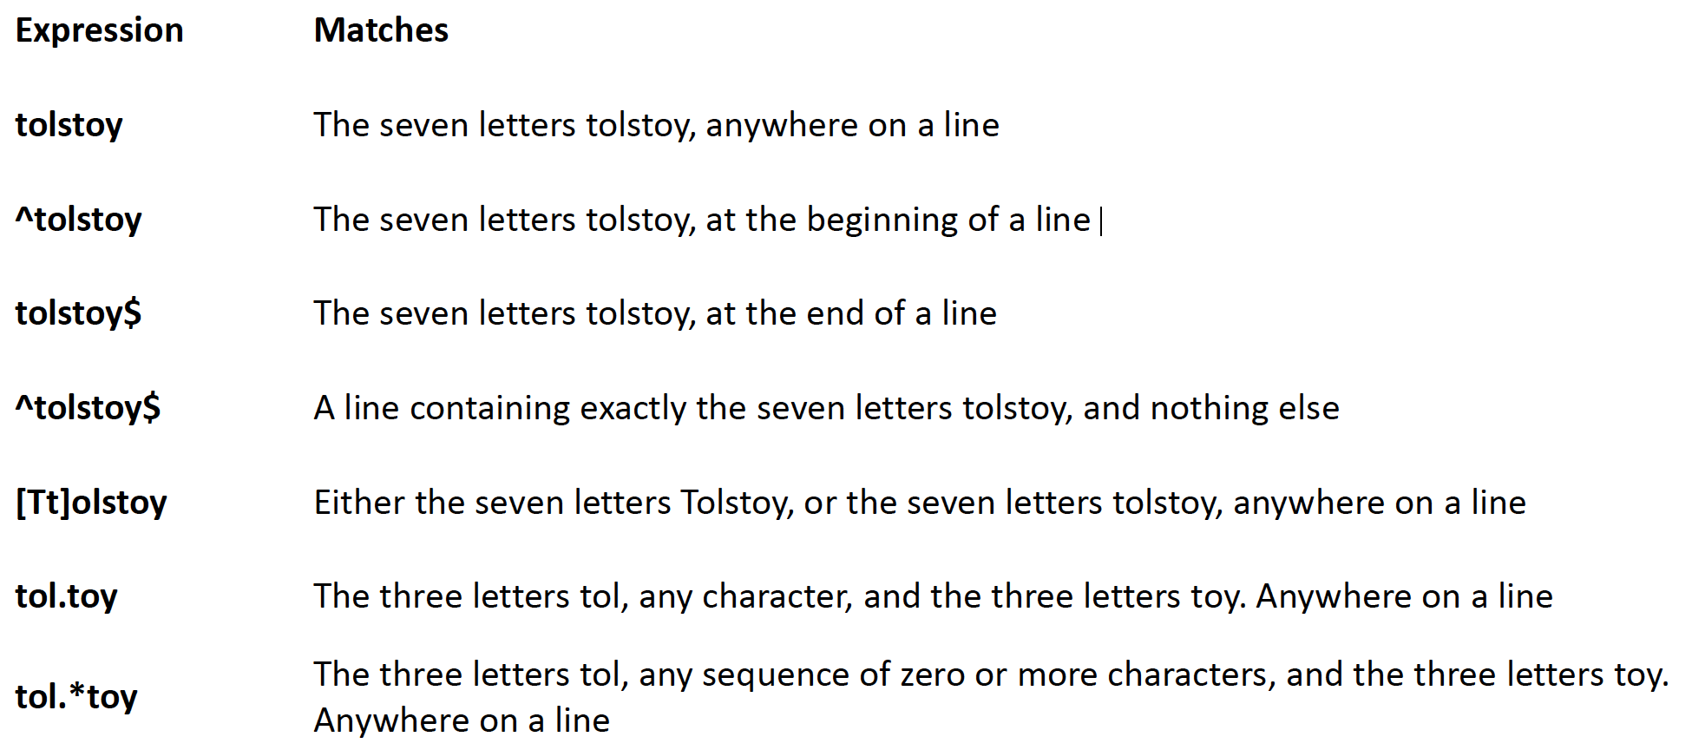
regex contd…

Slide 14
sed
stream editor, modifies the input as specified by the command(s)
Can be used for:
Printing specific lines or address ranges
sed –n ‘1p’ sedFile.txt
sed –n ‘1,5p’ sedFile.txt
sed –n ‘1~2p’ sedFile.txt
Deleting text
sed '1~2d' sedFile.txt
Substituting text - s/regex/replacement/flags
sed 's/cat/dog/' file.txt
sed 's/cat/dog/g' file.txt
sed 's/<[^>]*>//g' a.html
sed ‘s/regExpr/replText/’ filename
Notes:
first~step
Match every step'th line starting with line first. For example, sed -n 1~2p will print all the odd-numbered lines in the input stream, and the address 2~5 will match every fifth line, starting with the second. first can be zero; in this case, sed operates as if it were equal to step. (This is an extension.)

Slide 15
sed contd..
sed –n 12,18p file.txt
sed 12,18d file.txt
sed ‘1~3d’ file.txt
sed ‘1,5 s/line/Line/g’ file.txt
sed ‘/pattern/d’ file.txt
sed ‘/regexp/!d’ file.txt

Slide 16
grep
A Unix command to search files/text for the occurrence of a string of characters that matches a specified pattern
Usage:
grep [option(s)] pattern [file(s)]
grep –r ‘*.txt’ *
grep –c ‘line’ file.txt
grep –n ‘line’ file.txt
ls –l | grep *txt
Notes:
R = recursive
C = count
N = output is preceded by its relative line number

Slide 17
awk
awk is more than a command; it’s a programming language by itself
Utility/language for data extraction
awk views a text file as records and fields
Usage:
awk ‘/search pattern/ {Actions}’ file
Examples:
awk ‘{print;}’ file.txt // print the file line by line; default behaviour
awk ‘/Hello/ {print;}’ file.txt // prints lines which matches Hello
awk ‘{print $1,$2;}’ file.txt // prints only specific fields
awk –F’Hello’ ‘{print $2}’ // prints second column in between the occurrences of the specified pattern

Slide 18
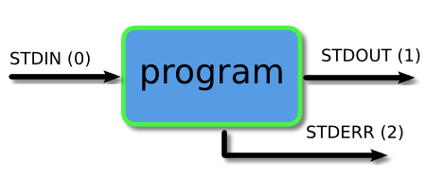
Piping and Redirection
Every program we run on the command line automatically has three data streams connected to it.
STDIN (0) - Standard input (data fed into the program)
STDOUT (1) - Standard output (data printed by the program, defaults to the terminal)
STDERR (2) - Standard error (for error messages, also defaults to the terminal)
Piping and redirection is the means by which we may connect these streams between programs and files to direct data in useful ways.

Slide 19
More About Piping and Redirection
Basic I/O Redirection
Most programs read from stdin
Write to stdout
Send error messages to stderr
Try: $ cat // With no arguments, read standard input, write standard output
Task: Piping and Redirection
Create a file test.txt with numbers 1-5 in descending order in each line
Delete all the new line characters (with tr command and redirection) and redirect output to test1.txt
Now, first sort the file and then repeat the above step; but instead of redirection, now append the output to test1.txt

Slide 20
The Shell and OS
What is a shell?
Outermost cover of the kernel
User’s interface to the OS
Use it to run your programs

Slide 21
Compiled Languages v/s Scripting Languages
Compiled Languages
Examples?
C,C++,Java
First Compiled
Source code to object code; then executed
Run faster
Applications:
Typically run inside a parent program like scripts, more compatible during integration, can be compiled and used on any platform (eg. Java)
Scripting Languages
Examples?
Python, JavaScript, Shell Scripting
No compilation required. Directly interpreted!
Interpreter reads program, translates into internal form and executes
Runs slower than a high level lang
Applications:
Automation, Extracting information from a data set, Less code intensive

Slide 22
Shell Script
A computer program designed to be run on a shell (UNIX/Linux)
All shell commands can be executed inside a script
Why use a shell script?
Simplicity
Portability
Ease of development

Slide 23
Basic Shell Constructs
Shell recognizes three fundamental kinds of commands:
Built-in commands: Commands that the shell itself executes (e.g.: echo)
Shell functions: Self-contained chunks of code, written in shell language
External Commands: mainly external utilities; backtick often associated
number=`ll | wc -l` // This is an external command
echo $number

Slide 24
Self-Contained Scripts: The #! First Line
When the shell runs a program, it asks the kernel to start a new process and run the given program in that process.
It knows how to do this for compiled programs but for a script, the kernel will fail, returning a “not executable format file” error so it’ll start a new copy of /bin/sh (the standard shell) to run the program.
But if there is more than one shell installed on the system, we need a way to tell the kernel which shell to use for a script
#! /bin/csh –f
#! /bin/awk –f
#! /bin/sh

Slide 25
Task: Understanding a Shell Script
Create a file testFile.sh
Write a statement to print “Hello World” inside it
Run the File with ‘sh testFile.sh’. What do you observe?
Now, add #!/bin/sh to the first line and repeat the above step
Did you see any difference?
Why?
Now, rename the file to testFile.txt and run it again.
Did you see any difference?
Why?

Slide 26
Variable in shell script
Start with a letter or underscore and may contain any number of following letters, digits, or underscores
Hold string variables
$ myvar=this_is_a_long_string_that_does_not_mean_much //Assign value
$ echo $myvar //Print the value
this_is_a_long_string_that_does_not_mean_much
first=firstName middle=s last=lastName Multiple assignments allowed on one line
fullname="$first $middle $last" Double quotes required here, for concatenating
fullname=“abc xyz mno" Use quotes for whitespace in value
oldname=$fullname Quotes not needed to preserve spaces in value

Slide 27
Variables in shell script contd…
Escape Character \ - Literal value of following character
echo \|
Single Quote - Literal Meaning of all within ‘’
$hello=1
$str=‘$hello’
echo $str -> $hello
Double Quote - Literal meaning except for $, ` and \.
$hello=1
$str=“abc$hello”
echo $str -> abc1

Slide 28
Variables in shell script contd…
Special Variables: certain characters reserved as special variables
$: PID of current shell
#: number of arguments the script was invoked with
n: nth argument to the script
?: exit status of the last command executed
echo $$; echo $#; echo $2; echo $?;
scalar variable vs array variable:
array_name[index]=value; echo ${array_name[index]}

Slide 29
Loops
ALL=`ls -a $dir | sort`
declare -a ARRAY
count=0
for FILE in $ALL
do
ARRAY[$count]=$FILE
…..
done
for var in list_values
do
command 1
..
command n
done
while condition
do
command 1
..
command n
done
for i in "${ARRAY[@]}”
do
…
done

Slide 30
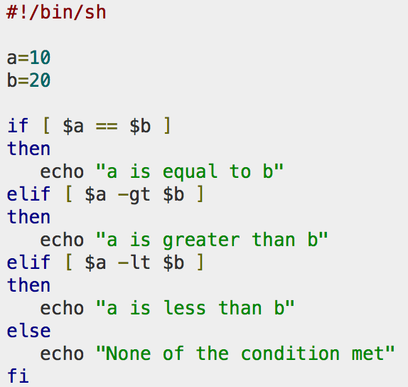
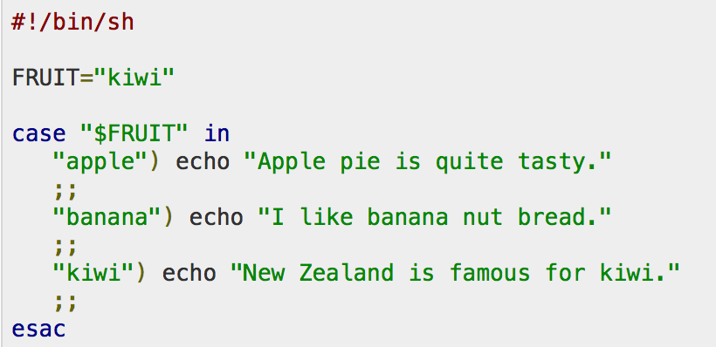
Conditional and Unconditional Statements
Conditional
if…then…fi
if…then…else…fi
if…then…elif..then…fi
case…esac
Unconditional
break
continue

